Slide 1
Pemograman Visual
Pertemuan 3 - Control
Muhammad Ikhwani Saputra, S.Kom, M.Kom

Slide 2
Visual Basic Controls
Starting a New Visual Basic Program
Text Box Control
Button Control
Label Control
List Box Control
Name Property
Fonts / Auto Hide
Positioning and Aligning Controls

Slide 3
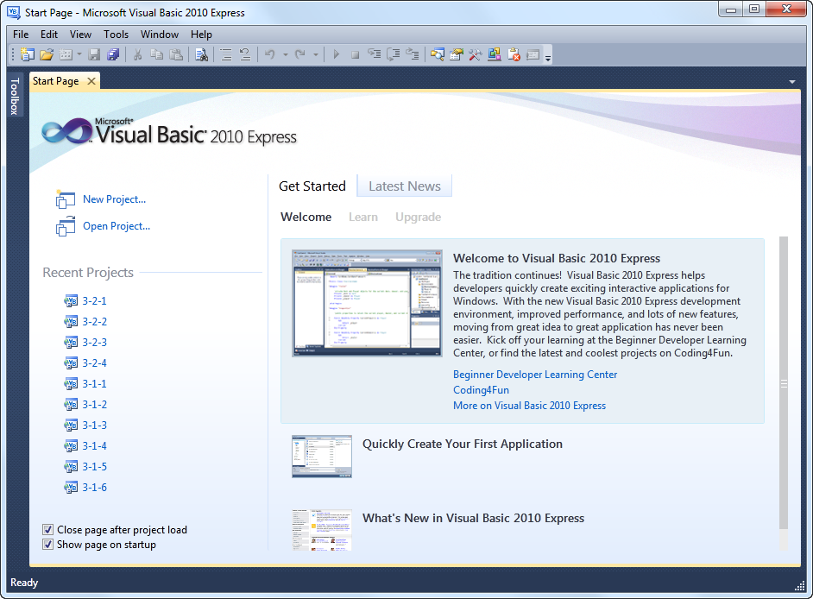
Visual Basic Start Page

Slide 4
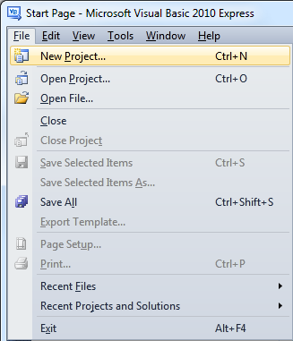
Start a New Project

Slide 5
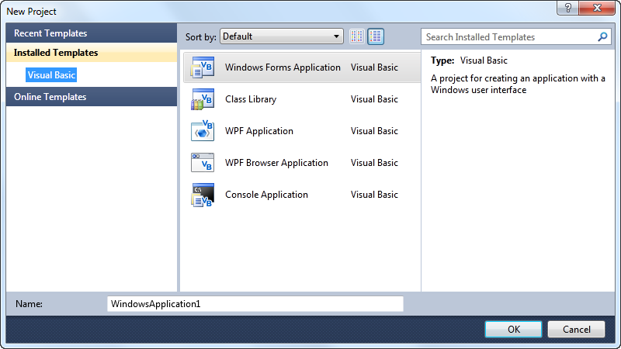
New Project Dialog Box
select
click on OK button

Slide 6
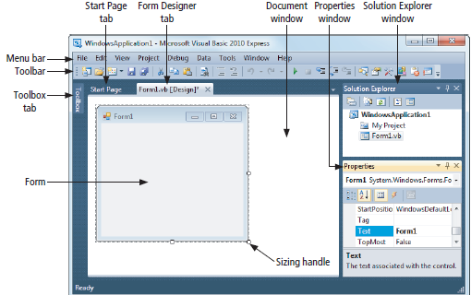
Initial Visual Basic Screen

Slide 7
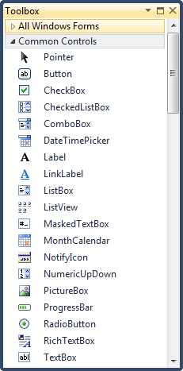
Toolbox

Slide 8
4 Ways to Place a Control from the Toolbox onto the Form Designer
Double-click
Drag and Drop
Click, Point, and Click
Click, Point, and Drag

Slide 9
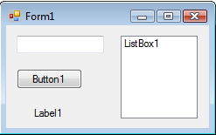
Four Controls at Design Time
text box
To select a control, click on it. Sizing handles will appear when a control is selected.

Slide 10
Text Box Control
Used for input and output
When used for output, ReadOnly property is set to True
Tasks button
sizing handles

Slide 11
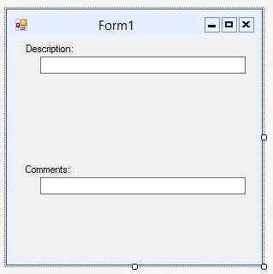
Label and Textbox
Textbox Properties
  PasswordChar
  Multiline
  ScrollBards
  ReadOnly

Slide 12
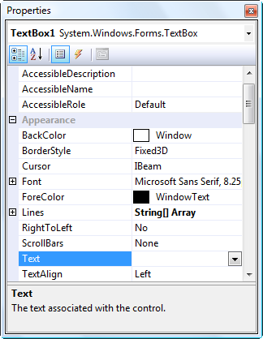
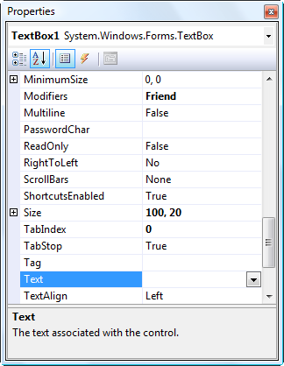
Properties Window
Press F4 to display the Properties window for the selected control.
categorized view alphabetical view

Slide 13
Properties Window (continued)
selected control
properties
settings
Description pane

Slide 14
Some Often Used Properties
Text
Autosize
Font.Name
Font.Size
ForeColor
BackColor
ReadOnly

Slide 15
Setting Properties
Click on property name in left column.
Enter its setting into right column by typing or selecting from options displayed via a button or ellipses.

Slide 16
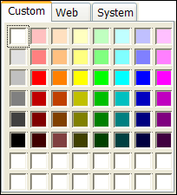
Setting the ForeColor Property
Click on ForeColor.
Click on button at right of settings box.
Click on Custom tab to obtain display shown.
Click on a color.
Notes:
The 16 white boxes at the bottom of the grid are used to create custom colors. (Explained in Appendix B.)

Slide 17
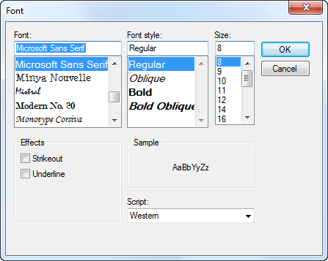
Font Property
Click on Font in left column.
Click on ellipsis at right of settings box to obtain display shown.
Make selections.

Slide 18
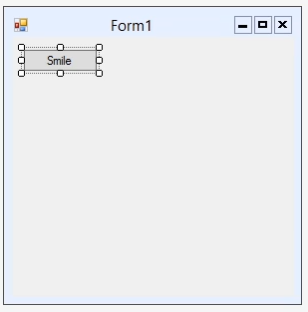
Button
Properties
  Name
  Text
  Image
  ImageAlign
  TextAlign

Slide 19
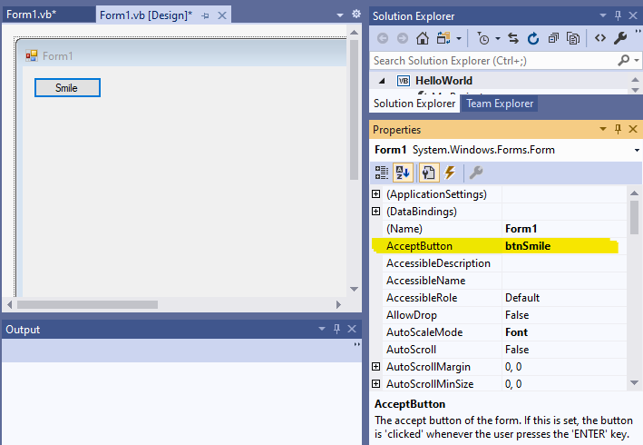
Button
Use AcceptButton property in Form Control to trigger Enter Keyboard

Slide 20
Button
Use AcceptButton property in Form Control to trigger Enter Keyboard

Slide 21
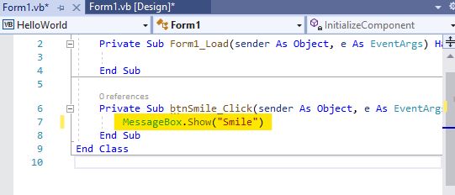
Button
The message Smile will show when user press the enter button

Slide 22
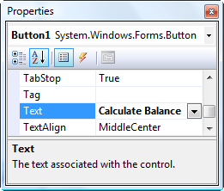

Button Control
The caption on the button should indicate the effect of clicking on the button.
Text property

Slide 23
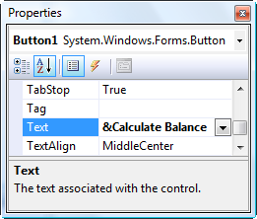

Add an Access Key

Slide 24
Label Control
Used to identify the contents of a text box.
Text property specifies caption.
By default, label automatically resizes to accommodate caption on one line.
When the AutoSize property is set to False, label can be resized manually. AutoSize is used primarily to obtain a multi-rowed label.

Slide 25
List Box Control
Initially used to display several pieces of output.
In Chapter 4 used to select from a list.

Slide 26
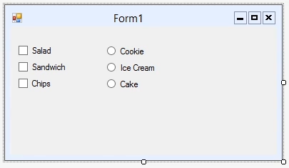
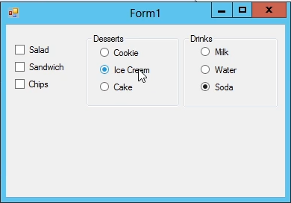
Checkbox and Radio Button

Slide 27
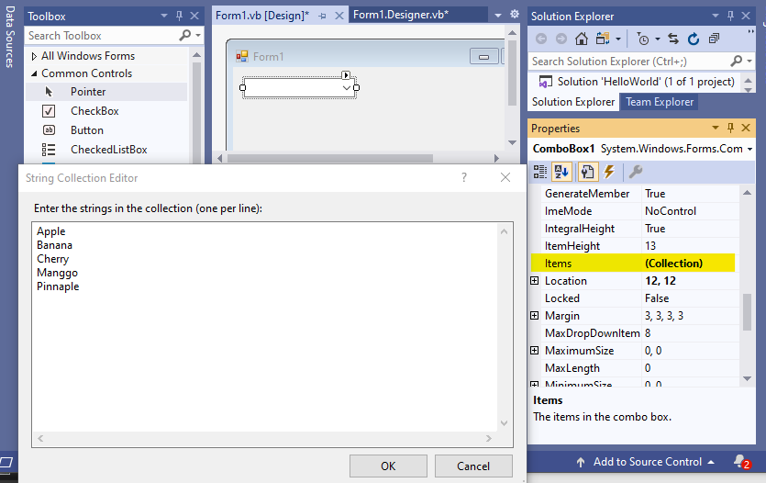
Combo Box

Slide 28
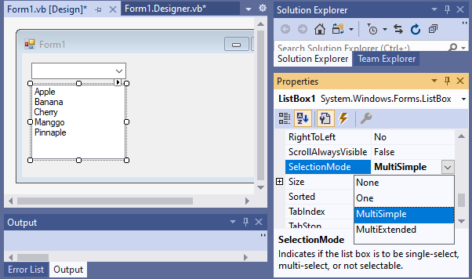
ListBox

Slide 29
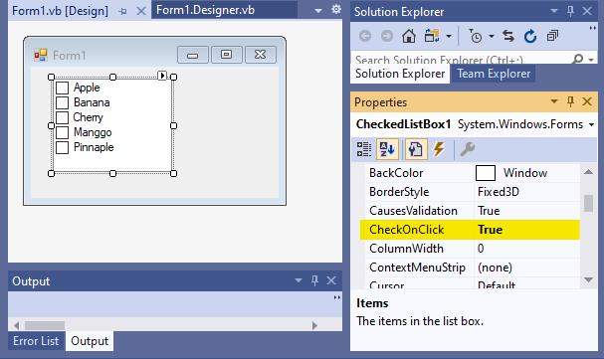
Checked Listbox

Slide 30
The Name Property
Used by the programmer to refer to a control in code
Setting for Name property near top of Properties window
Use appropriate 3-character naming prefix
Use descriptive names

Slide 31
Control Name Prefixes
Control | Prefix | Example
button | btn | btnCompute
label | lbl | lblAddress
text box | txt | txtAddress
list box | lst | lstOutput

Slide 32
Renaming the Form
Initial name is Form1
The Solution Explorer window lists a file named Form1.vb.
To rename the form, change the name of this file to newName.vb
newName should begin with prefix frm.

Slide 33
Fonts
Proportional width fonts, such as Microsoft Sans Serif, use less space for "I" than for "W"
Fixed-width fonts take up the same amount of space for each character – like Courier New
Fixed-width fonts are used for tables.

Slide 34
Auto Hide
Hides Toolbox when not in use
Vertical push pin icon indicates auto hide is disabled.
Click the push pin to make it horizontal and enable auto hide.
push pin

Slide 35
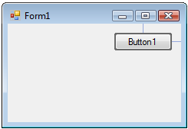
Positioning Controls
proximity line

Slide 36
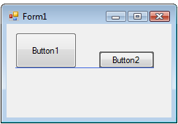
Aligning Bottoms of Controls
snap line

Slide 37
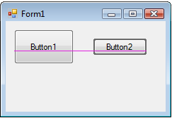
Aligning Middles of Controls
snap line

Slide 38
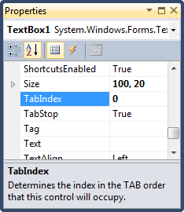
Tab Order
The tab indices determine the order in which controls receive the focus during tabbing.
The control whose TabIndex property is set to 0 has the focus when the program begins.
Notes:
Tab index determines the order in which the control receives the focus while tabbing.
Setting of tab order invoked from Edit window.

Slide 39
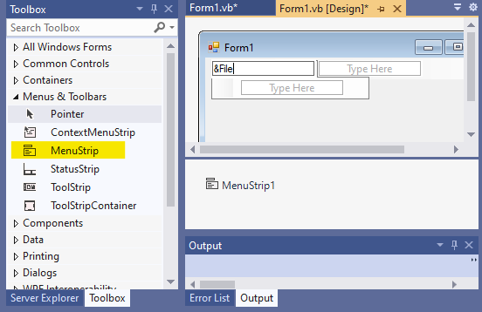
Menus

Slide 40
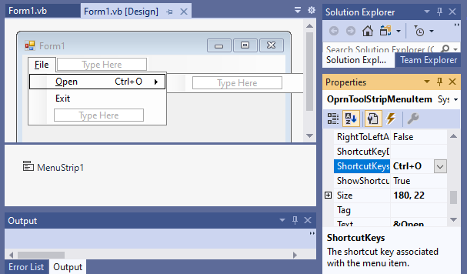
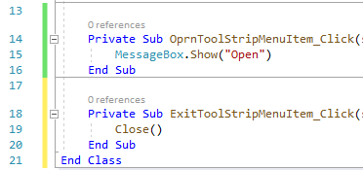
Menus

Slide 41
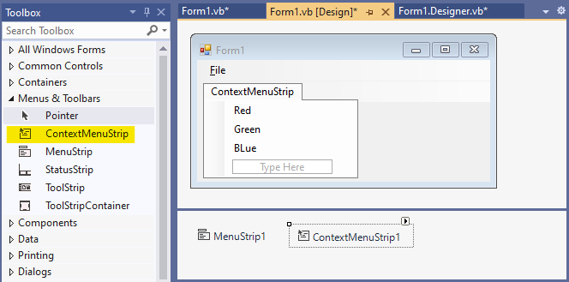
Context Menus

